Slide 1

Emotions Recognition in Images Bachelor’s Thesis
Student
Dragomir Sorin Alexandru
Scientific Coordinator
Prof. Univ. Dr. Ing. Brezovan Marius Vasile

Slide 2
Content
Application description
Why Emotions Recognitions In Images?
Application Flow
Application Interface
Version Control
GitHub
Bootstrap Themes
Upload Image
Webcam Capture
What is an API?
Why Face API (Microsoft)?
Face API behind the scenes
Detecting Emotions and Face Details using Face API
Upgrades and Improvements
Conclusions
Application Demo

Slide 3
Application Description
Web Application – ASP MVC
Detect one or more human faces in an image
Surrounds the detected faces
Recognizes the 6 main human emotions in images:
  anger
  contempt
  disgust
  fear
  happiness
  neutral
  sadness
  surprise
Predicts other face attribute features such as:
  hair details
  makeup details
  face accessories
  age
  gender
  smile

Slide 4
Why Emotions Recognitions In Images?

Slide 5
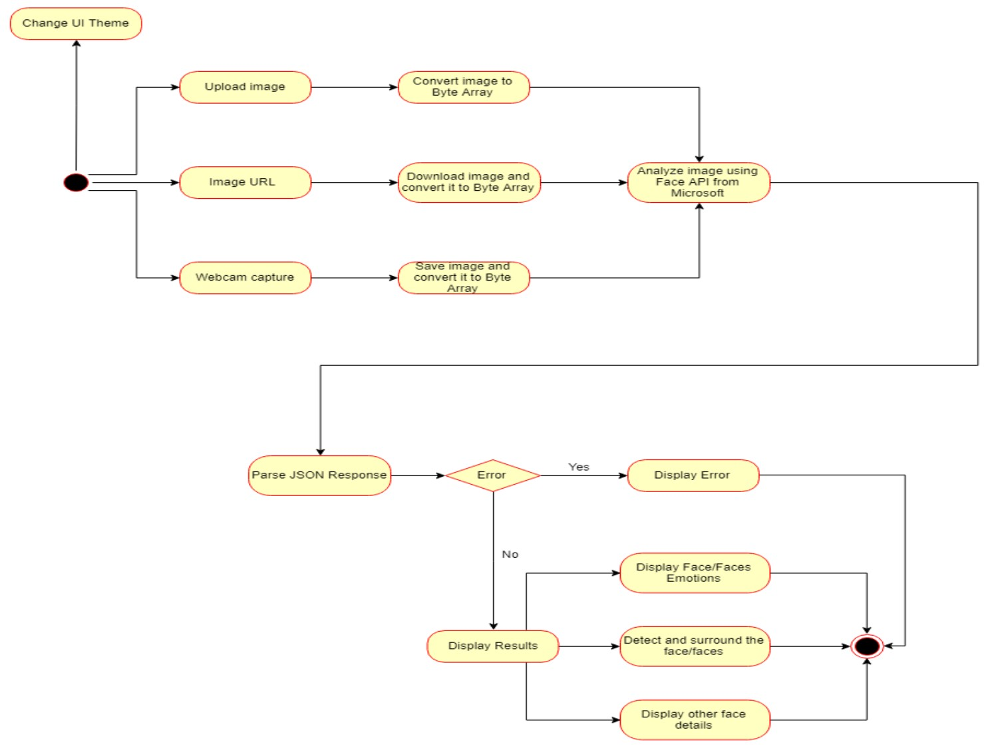
Application Flow

Slide 6
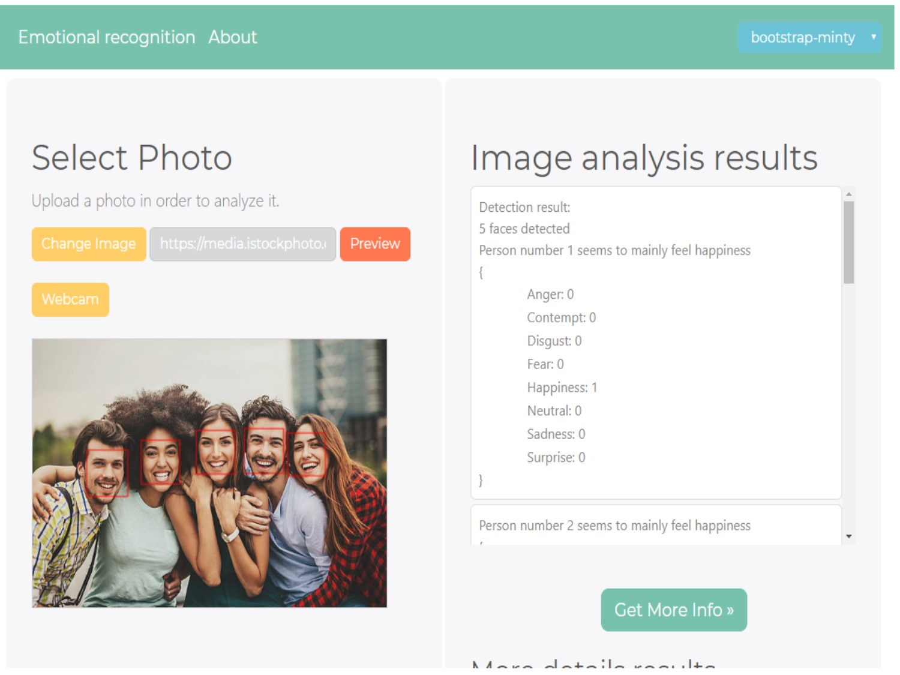
Application Interface

